Slide 1
3.2 Repetition Structures
ITP3914 – Programming
Part 3 – Basic Program Structures

Slide 2
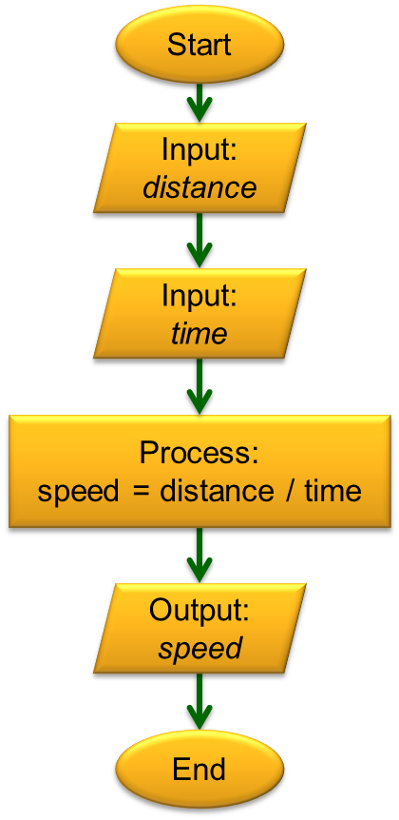
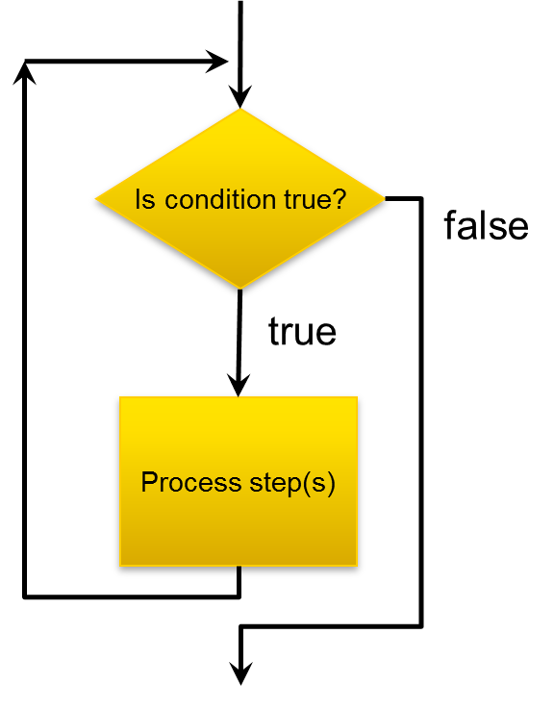
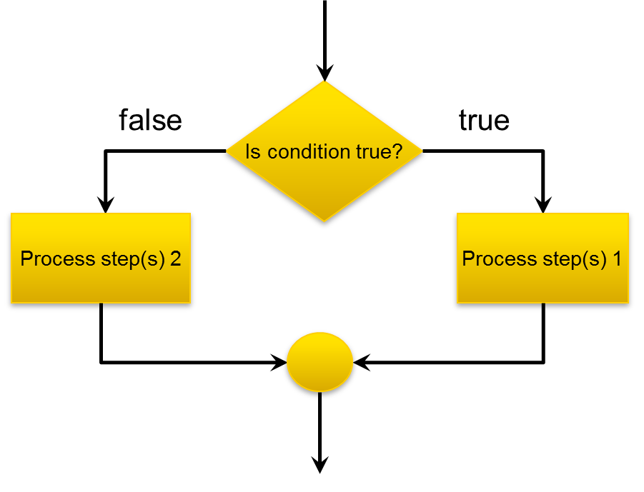
The Structure Theorem
The Structure Theorem states that it is possible to write ANY computer program by using only the three basic control structures:

Slide 3

Part 1 – The while statement

Slide 4

The Simple while loop
boolean condition
false
If the boolean condition evaluates to true, the loop_body is executed.
After executing the loop_body, test the condition again.
While condition is true, loop_body is executed again and again.
When the condition becomes a false, execute next_statement.
true
loop_body
while (condition)
loop_body;
next_statement;
next_statement

Slide 5
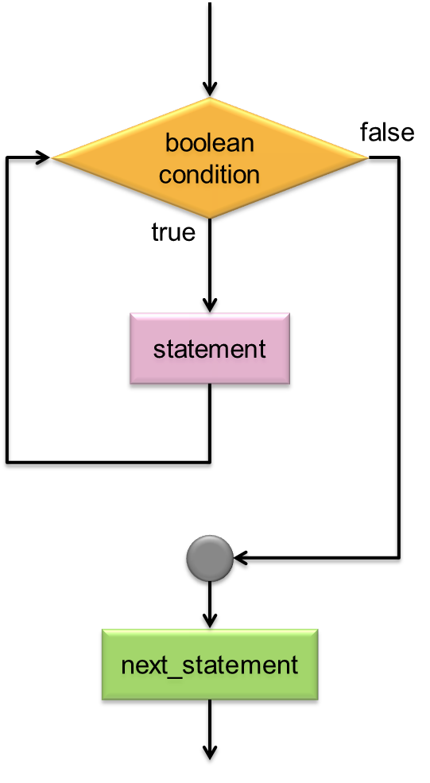
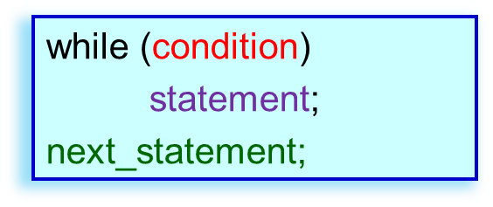
while Example 1
import java.util.*;
public class WhileEg1 {
public static void main(String [ ] args) {
int i=1;
int sum=0;
while (i < 4) {
sum += i;
i++;
}
System.out.println("Sum=" + sum);
}
}
i
1
sum
0
i
2
sum
1
i
3
sum
3
Loop
i
4
sum
6
c:\> java WhileEg1
Sum=6
The program calculates 1+2+3.
The while-loop body is executed 3 times.

Slide 6
In the last example (WhileEg1), the number of times the loop body is executed is set directly in the program source
begins with i=1
till and including i=3 (because condition is i < 4)
In the next example, the number of iterations is determined by the user during run-time!!!

Slide 7
while Example 2
import java.util.*;
public class WhileEg2 {
public static void main(String [ ] args) {
Scanner kb = new Scanner(System.in);
int i=0, n, value, sum=0;
System.out.print("How many? ");
n = kb.nextInt();
while (i < n) {
System.out.print("value? ");
value = kb.nextInt();
sum += value;
i++;
}
System.out.println("Sum = " + sum);
}
}
n
sum
0
i
0
value
n
3
i
1
value
10
sum
10
i
2
value
15
sum
25
i
3
value
8
sum
33
c:\> java WhileEg2
c:\> java WhileEg2
How many?
c:\> java WhileEg2
How many? 3
c:\> java WhileEg2
How many? 3
value?
c:\> java WhileEg2
How many? 3
value? 10
c:\> java WhileEg2
How many? 3
value? 10
value?
c:\> java WhileEg2
How many? 3
value? 10
value? 15
c:\> java WhileEg2
How many? 3
value? 10
value? 15
value?
c:\> java WhileEg2
How many? 3
value? 10
value? 15
value? 8
c:\> java WhileEg2
How many? 3
value? 10
value? 15
value? 8
Sum = 33

Slide 8
In the last example (WhileEg2), the program first asks the user for the number of times the loop is needed (value of n).
In the next example, we don't ask at all.
Instead, we check the data entered by the user to determine if the loop is to be continued!!!

Slide 9
while Example 3
import java.util.*;
public class WhileEg3 {
public static void main(String [ ] args) {
Scanner keyboard = new Scanner(System.in);
int value, sum=0;
System.out.print("value? ");
value = keyboard.nextInt();
while (value > 0) {
sum += value;
System.out.print("value? ");
value = keyboard.nextInt();
}
System.out.println("Sum = " + sum);
}
}
value
sum
0
value
3
sum
3
value
10
sum
13
value
20
sum
33
value
0
c:\> java WhileEg3
c:\> java WhileEg3
value?
c:\> java WhileEg3
value? 3
c:\> java WhileEg3
value? 3
value?
c:\> java WhileEg3
value? 3
value? 10
c:\> java WhileEg3
value? 3
value? 10
value?
c:\> java WhileEg3
value? 3
value? 10
value? 20
c:\> java WhileEg3
value? 3
value? 10
value? 20
value?
c:\> java WhileEg3
value? 3
value? 10
value? 20
value? 0
c:\> java WhileEg3
value? 3
value? 10
value? 20
value? 0
Sum = 33

Slide 10
while-loop Pitfalls
Infinite Loops – Loops that will never terminate because the boolean expression will never become false.
❶
int product=0;
while ( product < 5000 ) {
product *= 5;
}
product is always 0
❷
int count=1;
while ( count != 10 ) {
count += 2;
}
count goes as:
1, 3, 5, 7, 9, 11, …

Slide 11
You fix it!
Fix the logic error in the loop below.
The goal is to execute the loop body 10 times.
❶
int count=1;
while ( count < 10 ) {
count++;
}
❷
int count=0;
while ( count < 9 ) {
count++;
}

Slide 12
Part 2 – The do-while statement

Slide 13
The do-while loop
loop_body
The do-while loop is similar to the while loop except that the loop-body is executed once before checking the boolean condition.
boolean condition
do {
loop_body;
} while (condition) ;
next_statement;
true
false
next_statement

Slide 14
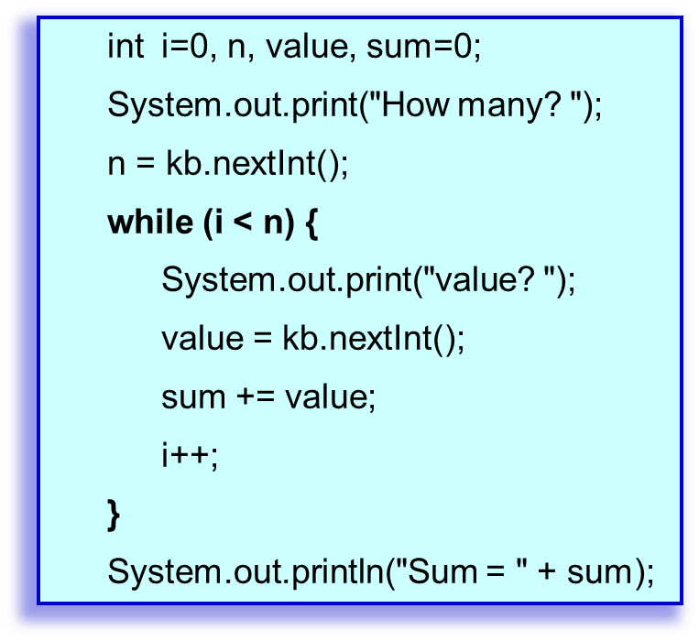
import java.util.*;
public class DoWhileEg {
public static void main(String [ ] args) {
Scanner keyboard = new Scanner(System.in);
int i=0, n, value, sum=0;
System.out.print("How many? ");
n = keyboard.nextInt();
do {
System.out.print("value? ");
value = keyboard.nextInt();
sum += value;
i++;
} while (i < n);
System.out.println("Sum = " + sum);
}
}
do-while example
c:\> java DoWhileEg
How many? 3
value? 10
value? 15
value? 8
Sum = 33

Slide 15
Exercise
Can you rewrite the program using do-while loop?
import java.util.*;
public class WhileEg3 {
public static void main(String [ ] args) {
Scanner keyboard = new Scanner(System.in);
int value, sum=0;
System.out.print("value? ");
value = keyboard.nextInt();
while (value > 0) {
sum += value;
System.out.print("value? ");
value = keyboard.nextInt();
}
System.out.println("Sum = " + sum);
}
}
Using do-while loop in this example is more simple.
but not necessarily
depends on the problem!
int value, sum=0;
do {
System.out.print("value? ");
value = keyboard.nextInt();
sum += value;
} while (value > 0);
System.out.println("Sum = " + sum);
c:\> java WhileEg3
value? 3
value? 10
value? 20
value? 0
Sum = 33
What is the deficiency of this program?

Slide 16
Part 3 – The for statement

Slide 17
Anatomy of while-loop
i=0
while ( ) {
}
i < 10
int i=0;
while-loop
false
i < 10
true
System.out.println("I am loop_body");
loop_body
i++;
i++
System.out.println("I am next_statement");
next_statement

Slide 18
From while to for
i=0
while ( ) {
}
i < 10
int i=0;
while-loop
false
int i=0;
i < 10;
i < 10
true
System.out.println("I am loop_body");
System.out.println("I am loop_body");
loop_body
i++
i++;
i++
System.out.println("I am next_statement");
System.out.println("I am next_statement");
for-loop
for ( )
next_statement

Slide 19
for-loop
i=0
i < 10
false
for ( int i=0; i < 10; i++ )
System.out.println("I am loop_body");
System.out.println("I am next_statement");
true
loop_body
i++
i starts with 0.
After each loop, i is incremented.
The condition is then checked again.
i changes as 0, 1, 2, 3, …, 9
At last i becomes 10 and the loop ends.
next_statement

Slide 20

for-loop example
Sum all numbers from 1 to 100.
int sum=0;
for (int num=1; num<=100; num++)
sum += num;
System.out.println( sum );
Sum all odd numbers between 0 and 100.
int sum=0;
for (int num=1; num<100; num+=2)
sum += num;
System.out.println( sum );

Slide 21
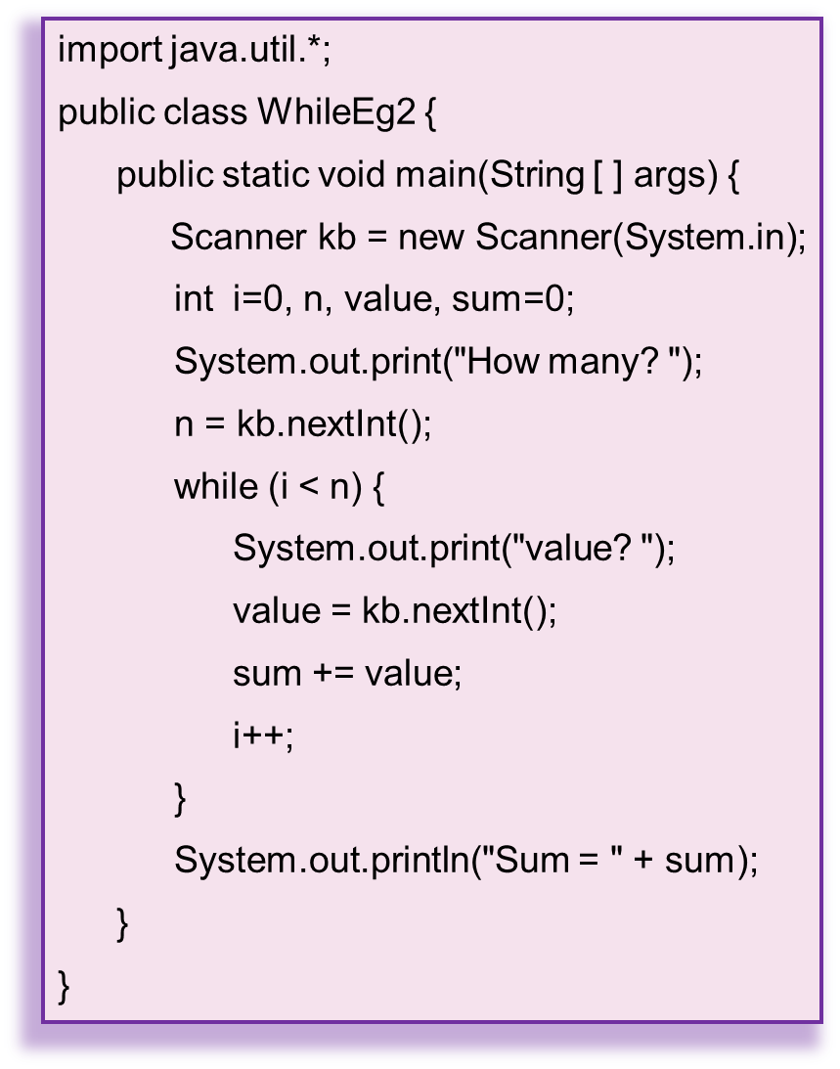
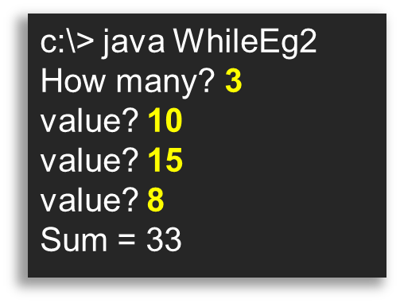
Rewriting while example 2
import java.util.*;
public class RewriteWhileEg2 {
public static void main(String [] args) {
Scanner kb = new Scanner(System.in);
int n, value, sum=0;
System.out.print("How many? ");
n = kb.nextInt();
for (int i=0; i<n; i++) {
System.out.print("value? ");
value = kb.nextInt();
sum += value;
}
System.out.println("Sum = " + sum);
}
}

Slide 22
Loop control examples
for (int i=0; i<100; i++) {
…
}
0, 1, 2, 3, …, 99
for (int i=0; i<=100; i++) {
…
}
0, 1, 2, 3, …, 99, 100
for (int i=1; i<100; i++) {
…
}
1, 2, 3, …, 99
for (int i=1; i<=100; i++) {
…
}
1, 2, 3, …, 99, 100

Slide 23
Loop control examples again
for (int i=100; i>=1; i--)
…
}
100, 99, 98, …, 1
for (int i=7; i<=77; i+=7) {
…
}
7, 14, 21, …, 77

Slide 24
Where to declare counter variable
Declare the counter variable before the for statement
int i;
for (i=1; i<=10; i++)
System.out.println( i );
System.out.println( i );
valid!
Declare the counter variable inside the for statement
for (int i=1; i<=10; i++)
System.out.println( i );
System.out.println( i );
Invalid!

Slide 25
END

